Slide 1
Problem Statement
In recent years, water quality has been threatened for various reasons. So, water caliber modeling and prediction have become very important to control water pollution. This proposed system presents a Classification model using different Machine learning algorithms for the purpose of analyzing water quality data from different water samples. There are certain limits of pollutants that water species can tolerate. Exceeding the limits affects the existence of creatures and threatens their lives. Utmost ambient water bodies similar as gutters, rivers, lakes, and streams have specific quality norms that indicate their quality. It is very important to have a new approach to analyze, predict and classify the caliber of water, based on the dimensions and properties of the water. This proposed system focuses on various statistical methods including sampling techniques like Over Sampling, Outlier detection and removal, correlation techniques and advanced machine learning algorithms in supervised learning which are used to predict the water potability classification. The water quality is veritably important in ensuring citizens get to drink clean water. Application of random forest algorithm as a data mining method to predict clean water sample based on the water quality parameters can ease the work of the laboratory technologist by prognosticating which water samples should proceed to the next step of analysis.

Slide 2
Motivation
Now a days water has been polluting a lot by industries and etc. In order to make sure that the particular water is drinkable or not is very important. That motivated me to propose a system that having an new approach by analysing the data and applying the machine learning algorithms.

Slide 3
DESIGN AND METHODOLOGIES
MODULE 1:
Data collection and Data gathering.
MODULE 2:
Performing Exploratory Data analysis and pre-processing of data.
MODULE 3:
Applying Statistical methods of machine learning.
MODULE 4:
Applying Efficient Algorithms ,Training and Testing the Data.

Slide 4
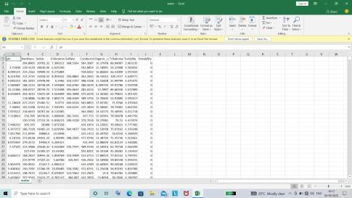
Module-1
Data Collection
Step:1 Collection of data From Kaggle and retrieving the data in Jupyter note book using Pandas.

Slide 5
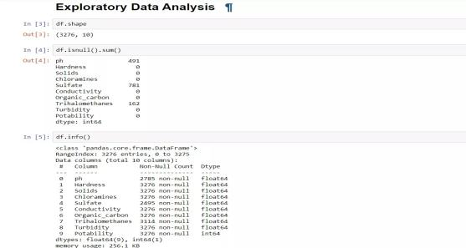
Module-2
Performing Exploratory Data analysis and pre-processing of data.
Step 1: In ED analysis, Firstly check the shape of the data set. Further, check that there are Null values present or not and we can find in the below image that ph, Sulfate, Trihalomethanes contain NULL values. Further, check the information of the data set.

Slide 6
Module-3
Applying Statistical methods like Over Sampling, Outlier Detection and removal.
As the data is imbalanced we performed Over Sampling to equalize the data in respective of our dependent variable. Over sampling is a technique to balance Uneven datasets by keeping all of the data in the majority class and increasing the size of the minority class. It is a significant technique data scientists can use to extract more accurate information from originally imbalanced datasets.
Having an outlier is not good to train the data.so using Empirical Formula technique we detected and removed the Outlier. It is a key tool in safeguarding data quality, as anomalous data and errors can be removed and analyzed once identified. Outlier detection is an significant part of each stage of the machine learning process.

Slide 7
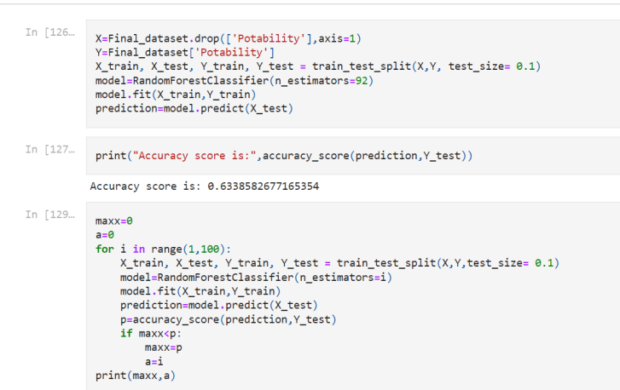
Module-4
Training the Model
Divide the data into the separate independent and dependent features. All the features are independent except Potability because Potability is our dependent feature.
Now, Split the data set into the training and testing by using the train_test_split function which returns four data sets.
Likewise, define the different classifier models and train the model using the data set ( X_train, Y_train ).

Slide 8
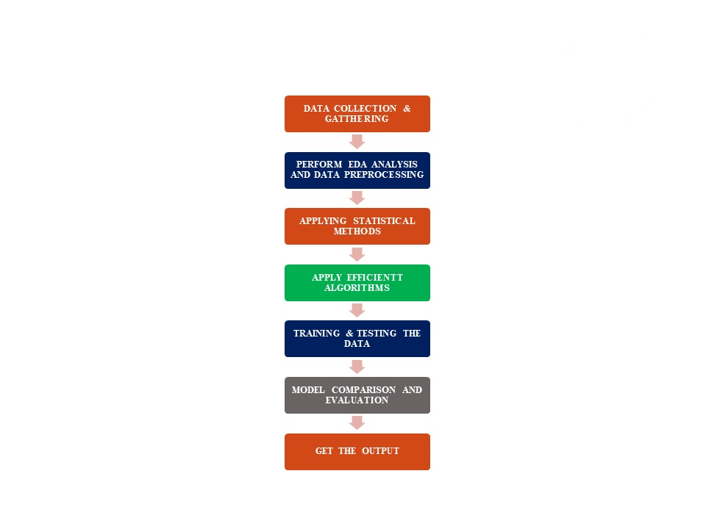
Data Flow Diagram

Slide 9
Efficiency of the Proposed System
It is observed that human beings are mostly machine dependent. It has become a normal tendency of people to move towards sources that reduce their work. The idea of this project mostly evolves to find better efficient algorithm with the processing time of the tests performed while data collecting and analyzing the water samples. The proposed system will achieve high classification. Therefore portability feature is estimated with good accuracy. For future purposes, this project is capable of predicting portability by providing web page access also. This project has served its importance and will gain more recognition in the following years.

Slide 10
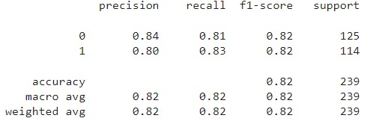
Test Results

Slide 11
Conclusion
Access to safe drinking water is essential factor to health, a basic human right and a element of effective policy for health protection. It is important as a health factor and development issue at a national, regional and local level. In some regions, it has been found that investments in water supply and sanitation can yield a net economic benefit successfully. since the reductions in adverse health effects and health care costs outweigh the costs of undertaking the interventions.
Likewise our model predicts whether the water is safe to drink or not using few parameters such as Ph value, conductivity, hardness, etc.,
The data were collected and trained using a machine learning algorithm, and the predicted data has been tested

